Slide 1
Mastering String Slicing in Python
A Comprehensive Guide to String Slicing Techniques

Slide 2
Introduction to String Slicing
What is String Slicing?
Why is it Useful?
String slicing is a way to extract a part of a string using index positions.
It allows you to create substrings by specifying a start, stop, and step.
Efficiently access and manipulate parts of strings.
Essential for data extraction and string manipulation tasks.

Slide 3
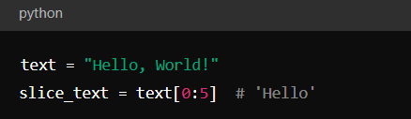
Basic Syntax of Slicing
string[start:stop:step]
start: The starting index (inclusive).
stop: The stopping index (exclusive).
step: The interval between characters.
Example :

Slide 4
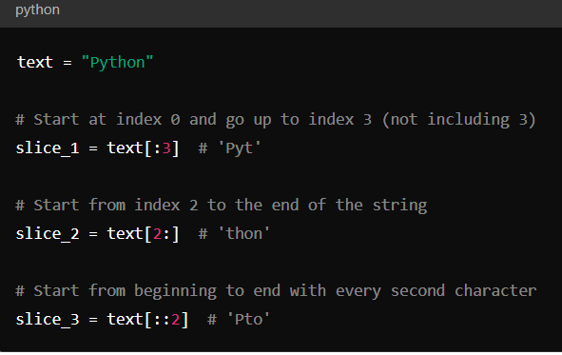
Slicing with Default Parameters
Omitting Start, Stop, or Step:
If start is omitted, slicing starts from the beginning.
If stop is omitted, slicing goes to the end of the string.
If step is omitted, the default step is 1.
Example:

Slide 5
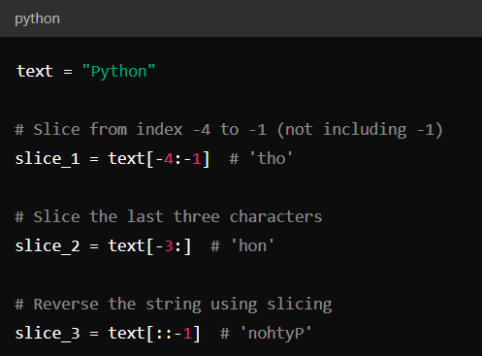
Negative Indexing in Slicing
Using Negative Indices:
Negative indices allow you to slice from the end of the string.
-1 refers to the last character, -2 to the second last, and so on.
Example:

Slide 6
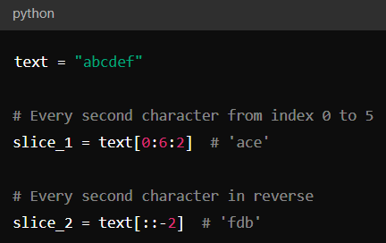
Step Parameter in Slicing
The step parameter defines how many characters to skip.
A positive step moves forward, and a negative step moves backward.

Slide 7
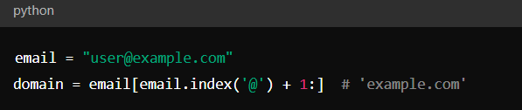
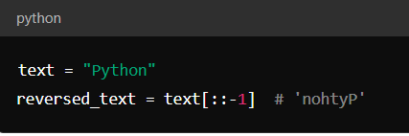
Practical Applications of Slicing
Extracting Substrings:
Example: Extracting a domain from an email.
Reversing Strings:
Example: Reversing a string.

Slide 8
Practice Exercise
Task:
Given the string sentence = "Python slicing is powerful", extract:
The word "slicing".
The word "powerful" in reverse.
The sentence without the first and last word.
Task:
Check if a string is a palindrome.

Slide 9
THANK YOU
Happy learning!

